Slide 1

Regional Well-Being In Different Countries Over The World
Maged Kharshom, Franco Bonifacini, Precious Prince, Akash Mittal

Slide 2
Introduction
Objective Of Study
Estimating the effect of Various Factors (like Health, Education, Income etc.) on the Life Satisfaction using MEMs.
Clustering of Various Factors (like Health, Education, Income etc.) into different clusters of Life Satisfaction

Slide 3
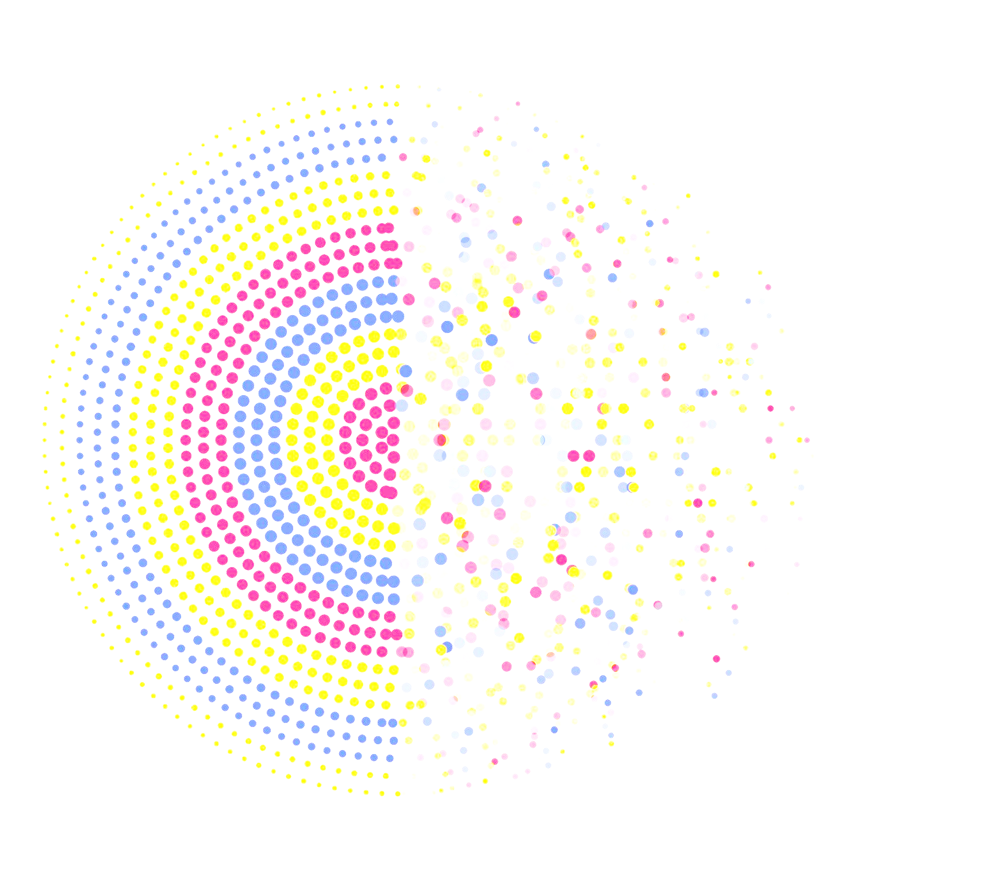

Data Collection & Pre-Processing
OECD Database: Indicators and Life-Satisfaction Scores for different regions within the different countries.
Data is not consistent with years for all countries, but is consistent in a way that it is “the latest available data”.
Assumption: We assumed that in a year or two, there are barely any drastic changes in a country policies or life-satisfaction scores.
Data Cleaning: Removing cases that have 100% missing values in some attributes.
Data Imputation Using the cities' medians for remaining missing vlaues.
OECD DataBase
Data Source : https://www.oecdregionalwellbeing.org/assets/downloads/OECD-Regional-Well-Being-Data-File.xlsx

Slide 4

Data Collection & Pre-Processing (cont.)
Original Dataset
Dimensions
447 records
Null Values Treatment
Exclude countries with 100% null values in some attributes.
Correlation Treatment
Remove attributes with more than 80% correlation, includes the features given in % terms.
28 columns
Median of Features for a Country to replace the remaining nulls.
COLUMNS
14
50%
ROWS
285
63%

Slide 5
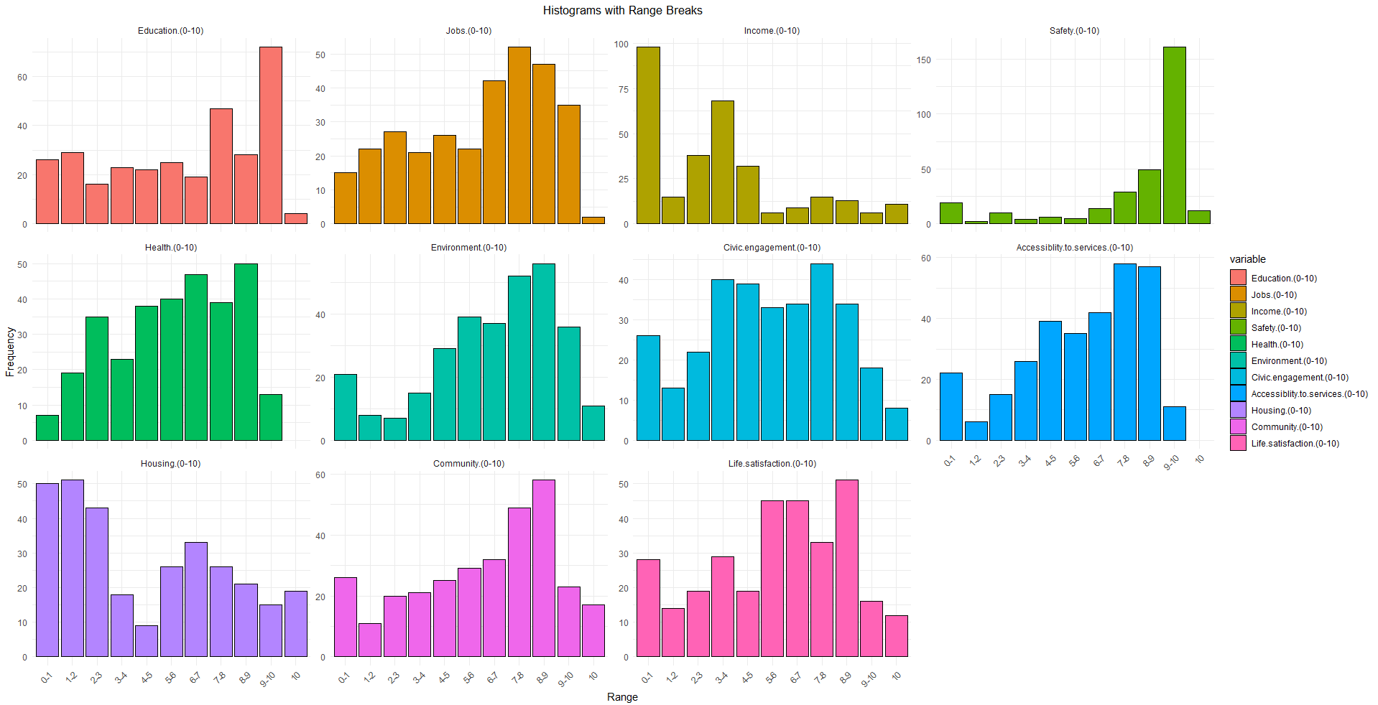
Data Overview

Slide 6
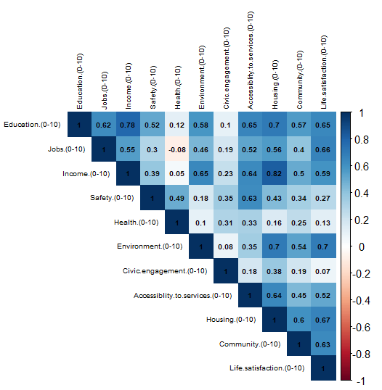
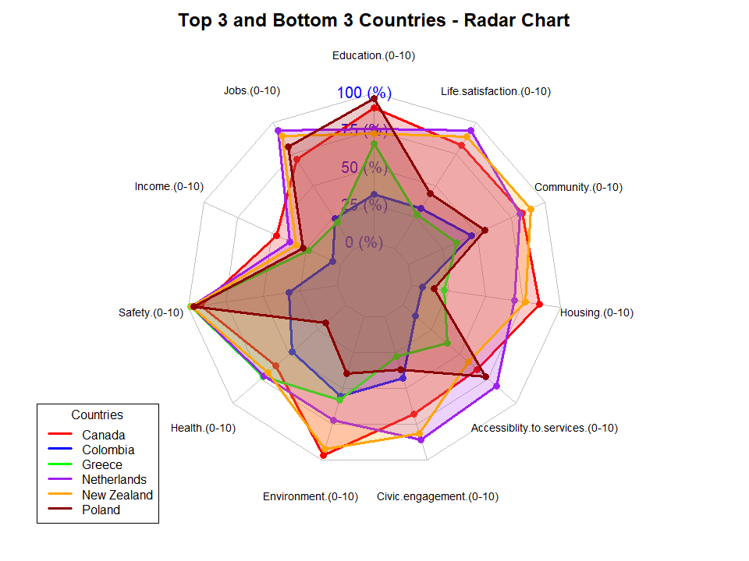
Data Overview

Slide 7
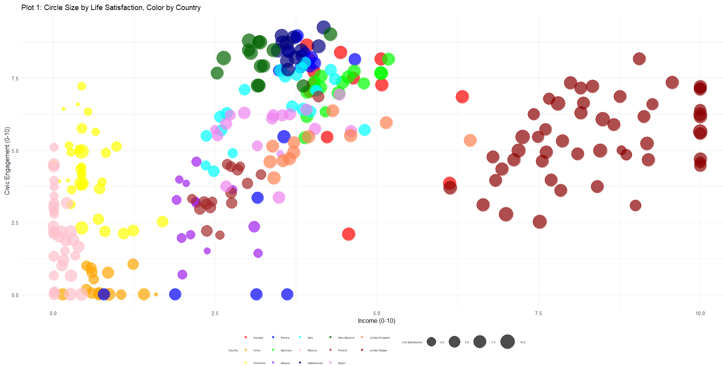
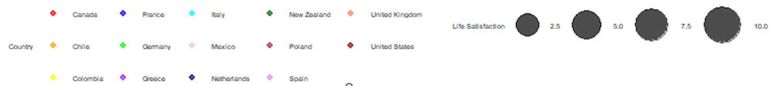
Data Overview

Slide 8
Choice of Models
Data
Countries
Cities within Countries
Different Independent Variables
Masking -
Life Satisfaction Score
Model Based Clustering
Clustering
Data
Countries
Cities within Countries
Different Independent Variables
Target Variable - Life Satisfaction Score`
Mixed Effect Models
Presence of Grouping/ Hierarchical Structure
Estimation of Effects

Slide 9
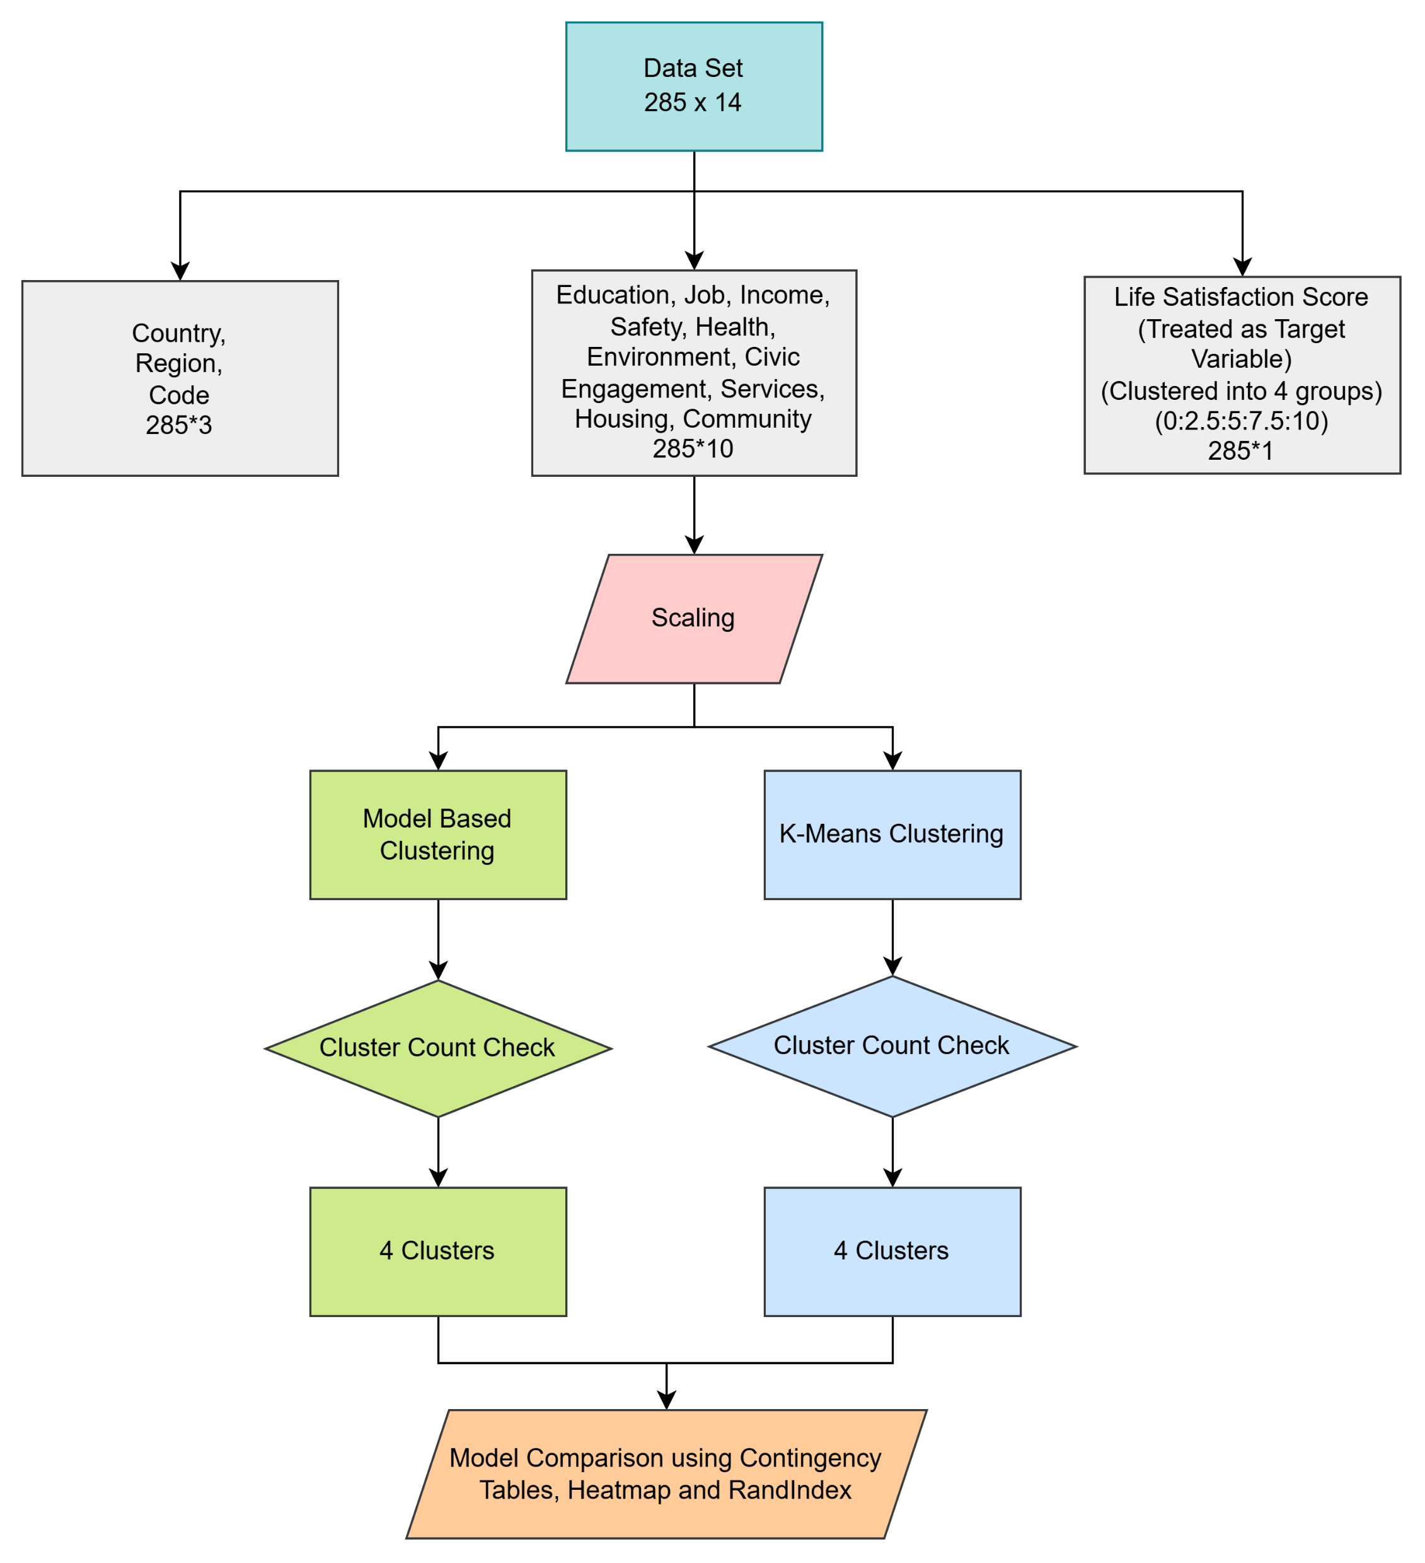
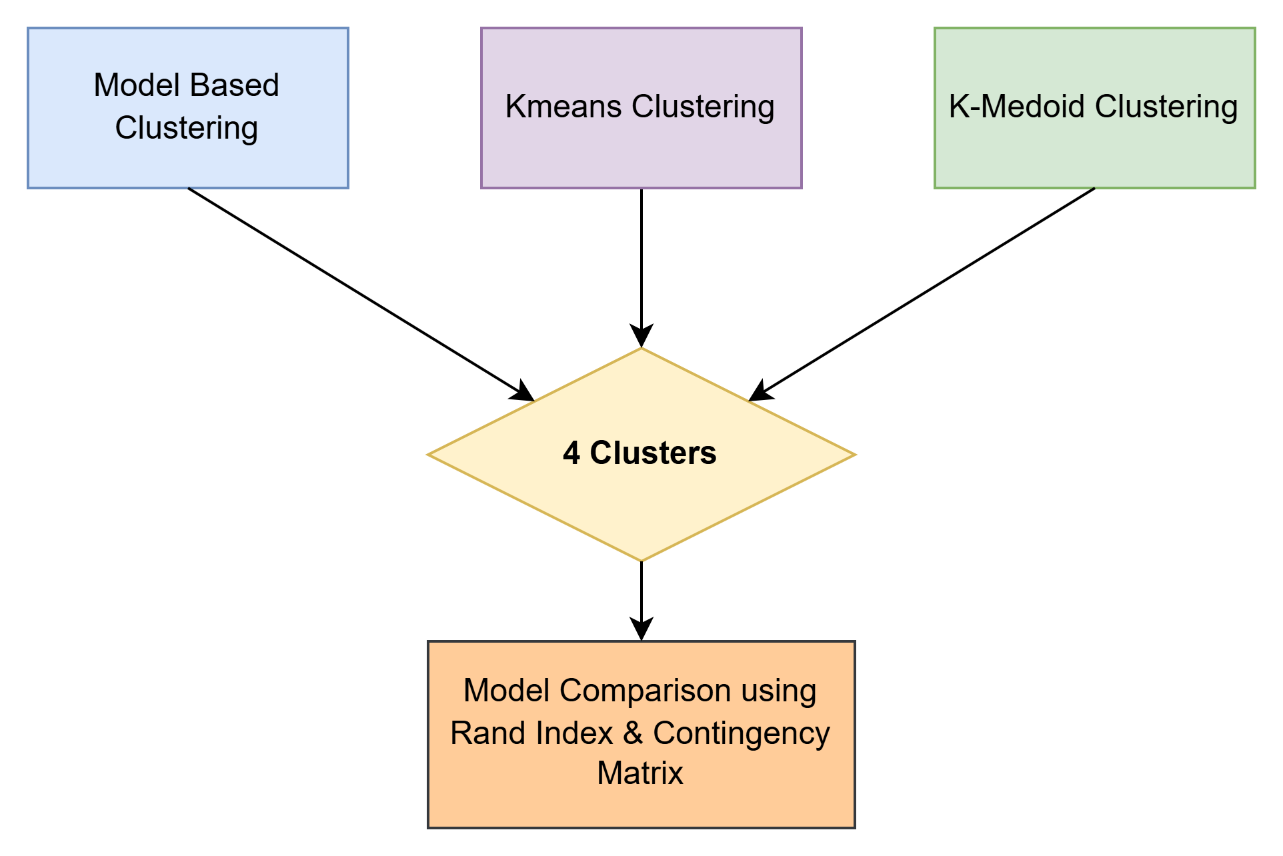
Clustering: Flowchart

Slide 10
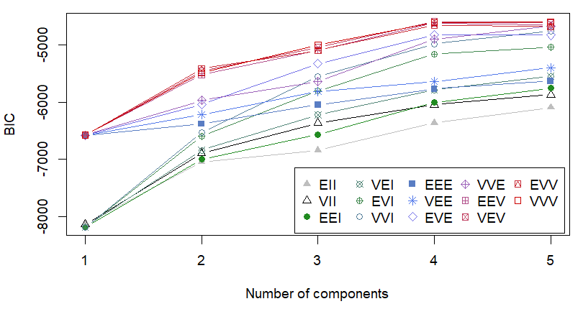
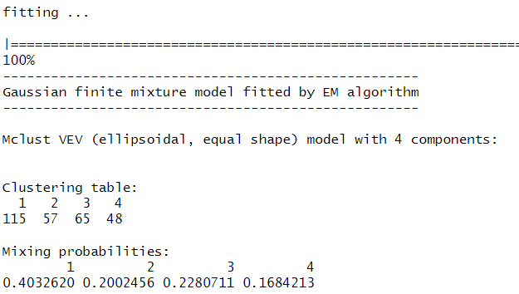
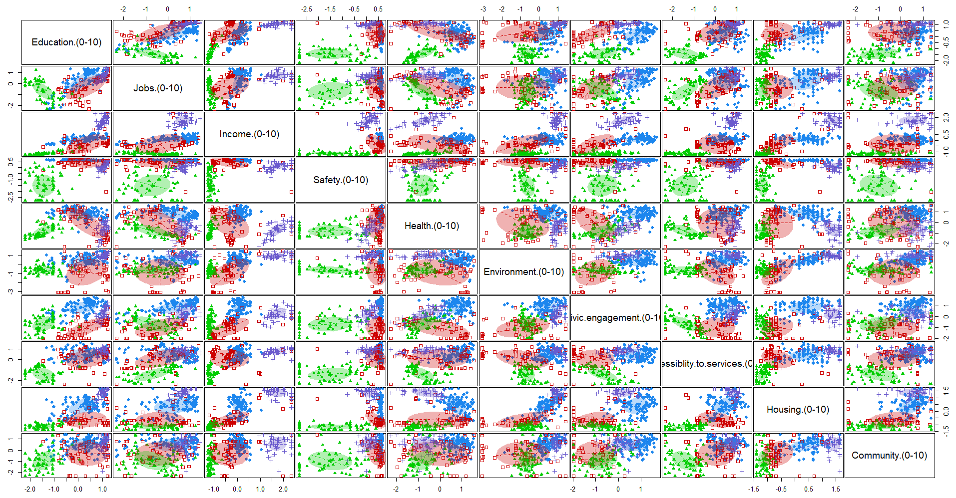
Model Based Clustering - Overview (1/3)
Clustering
Implementing the Model Based Clustering with upto 5 clusters, and choosing 4 as the best clusters based on BIC.
BIC for 4 clusters is -4589.206
Optimal Model -> Mclust VEV (Ellipsoidal, Equal Shape)

Slide 11
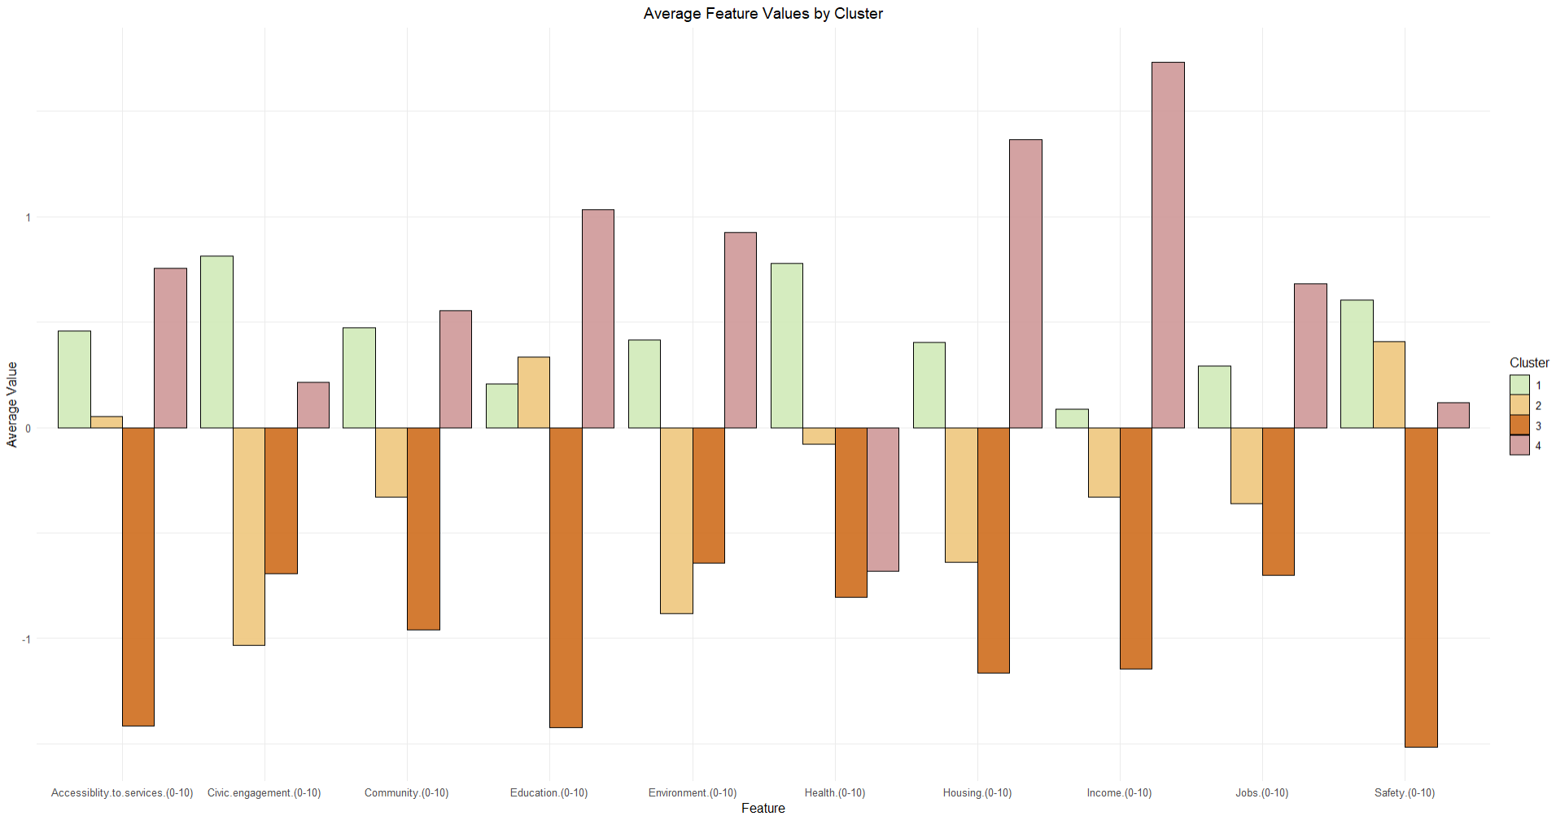
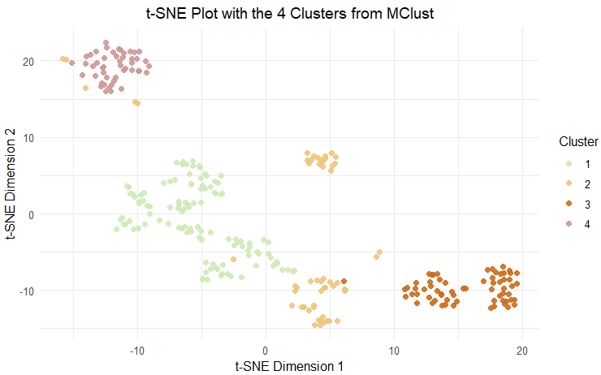
Model Based Clustering – Cluster Analysis (2/3)
Plot showing separated clusters in high dimension by t-SNE
Cluster 2: Looks more dispersed than others.
On Average Distribution of Features among the 4 Clusters
Cluster 1 : All features with above average values
Cluster 3 : All features with below average values

Slide 12
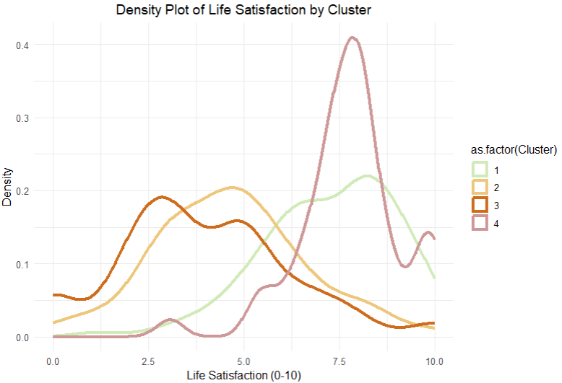
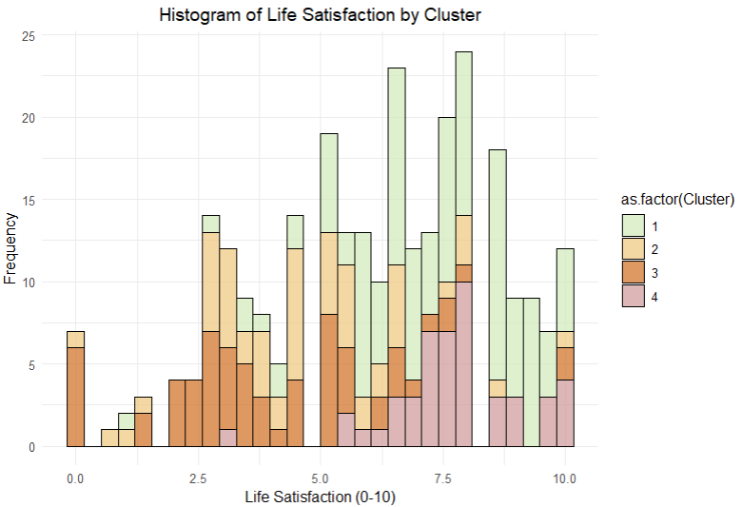
Model Based Clustering – Cluster Analysis (3/3)
Density Distribution among the four clusters
Cluster 2 & 3 : Have Significant Overlap
Cluster 1 and 4 : Have Significant Overlap
On Average Distribution of Features among the 4 Clusters
Cluster 1 : Significant contribution towards higher Scores*
Cluster 2 : Very Low to above average scores*
Cluster 3 : Very Low to Above Average*
Cluster 4 : Above Average Scores*

Slide 13
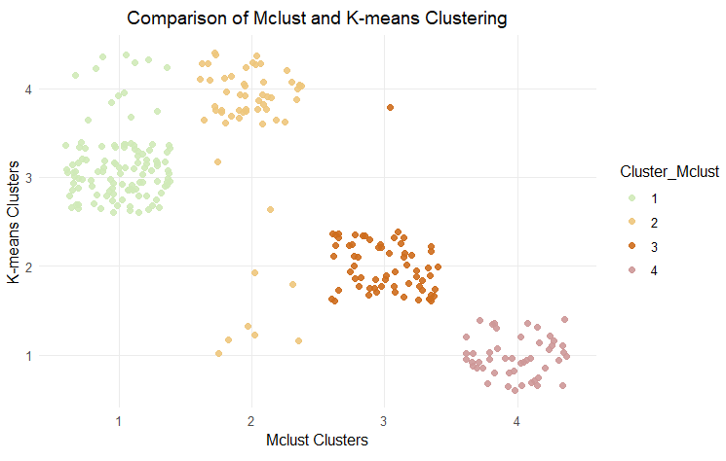
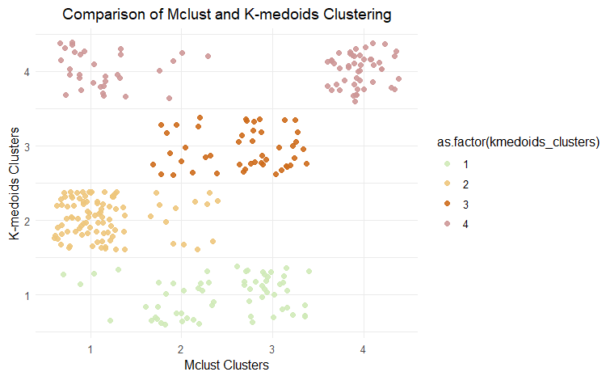
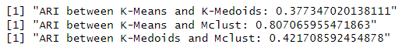
Comparison with K-Means and K-Medoids
From the Above Scatter Plots, we can clearly see that K-Means is more in line with the clusters with MClust. However, K-Medoids has quite a variation in clusters than that of K-Means and MClust.
Rand Index Comparison

Slide 14
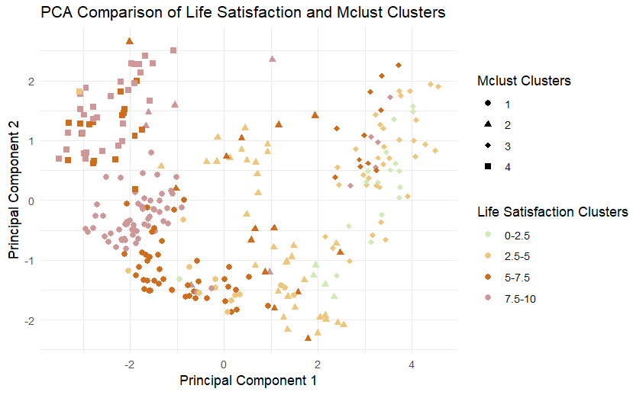
Cluster Comparison for MClust with Simple Metric Division of Life Satisfaction Scores

Slide 15
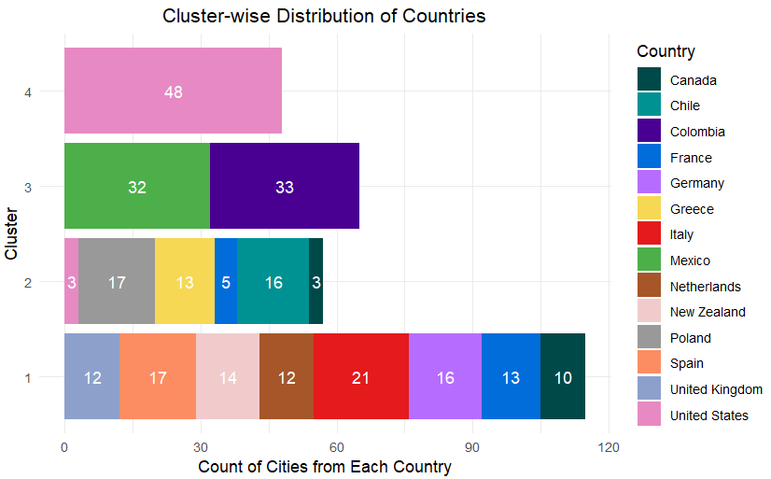
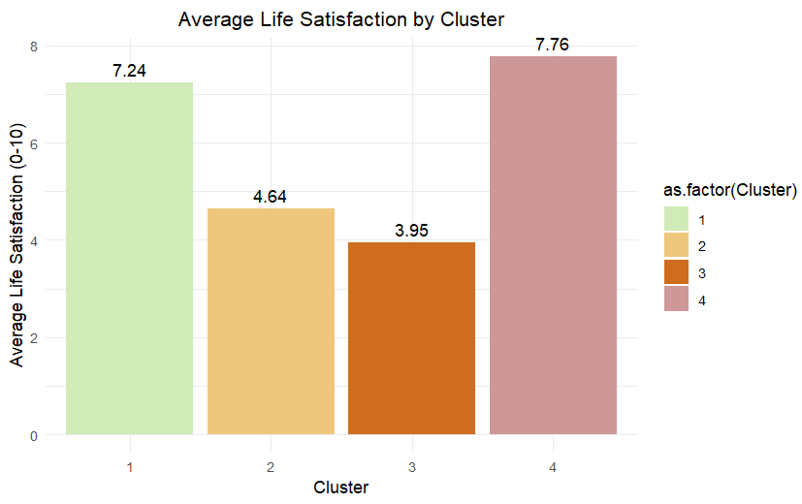
Countries/ Regions among the Clusters and the Average Life Satisfaction Scores

Slide 16
Conclusion
Cluster Assignment vs. Agreement:
Rand Index: 0.807
The Rand Index of 0.807 between the clusters from MClust (a probabilistic approach) and K-Means (a hard clustering method) show a strong agreement between the clusters, showing well-separated groups in the data.
Differences with Original Clusters (Life Satisfaction: 0-10 grouped in 4 groups, 0-2.5, 2.5-5, 5-7.5, 7.5-10):
The grouping does not have that much overlap with the Life-Satisfaction groups, and the reasons could be:
Life Satisfaction has been grouped based on threshold values in 4 groups, without any prior and they might not align with the actual clustering boundaries, as there might not be any distinct boundaries.
The number of groups we checked from 2 to 5, for them also the agreement between K-Means and MClust was not even that good, ranged from 30% to 76%, and stayed around 80% for 5 clusters, with no specific improvement.
The variables in data, ex. Education, Job, Income would have more complex relationships that does not specifically follow the Life-Satisfaction based scores, as the parameters are subjective for people to rate their life satisfaction score based on different factors.
Life Satisfaction Scores segmented data based on simple metric, but clustering algos grouped data based on multi-dimensional clustering.

Slide 17
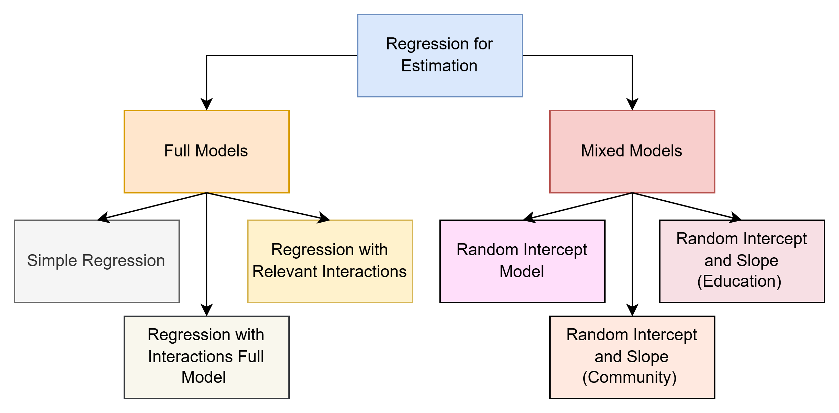
Regression: Flowchart
Model Comparisons

Slide 18
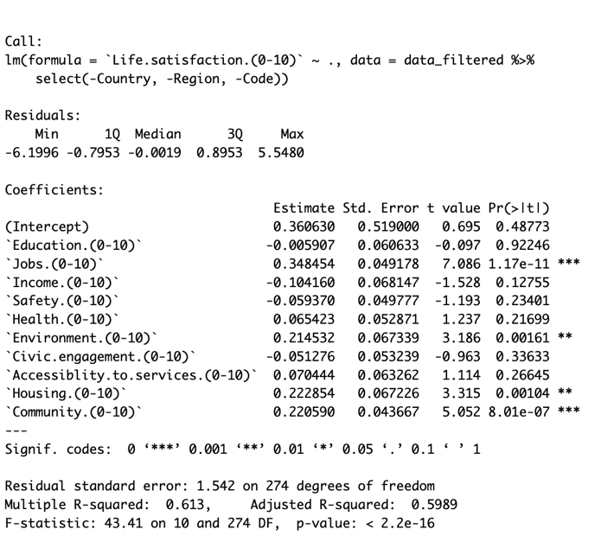
Model 1: Linear Regression
Key Insights on Life Satisfaction Regression Model 1:
Model Performance: Explains 61.3% of variation in life satisfaction (Adjusted R² = 59.9%).
Significant Predictors:
Jobs (0-10): Strongest effect (Estimate = 0.348).
Environment (0-10), Housing (0-10), and Community (0-10): Positive associations (p < 0.01).
Non-Significant Factors: Education, Income, and Safety.
Variability: Residual standard error = 1.542, indicating moderate unexplained variation.
Conclusion: Key contributors identified, but the model could improve in capturing additional factors.

Slide 19
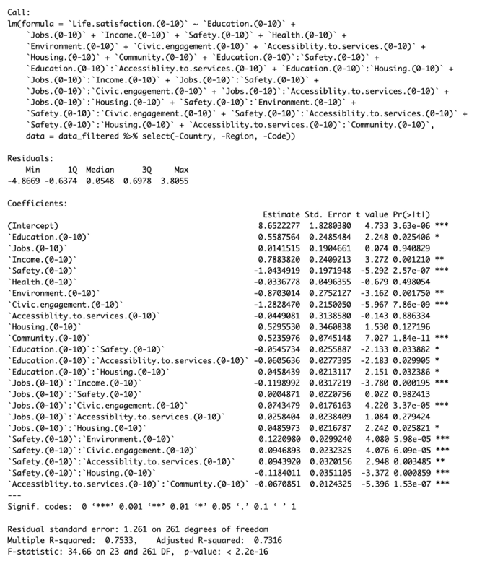
Model 3: Model with Interaction effects based on relevance of factors
Key Insights on Life Satisfaction Regression Model 2:
Model Performance: Adjusted R² = 0.7316, explaining substantial variation in life satisfaction.
Key Positive Predictors: Income, Community, and Jobs (interacting with Civic Engagement).
Key Negative Predictors: Safety, Civic Engagement, and Environment.
Notable Interactions:
Education × Accessibility to Services.
Safety × Housing.
Conclusion: Complex interactions underscore the need for targeted, context-sensitive policies to enhance life satisfaction.

Slide 20
Full Model comparison
Metric | Model 1 | Model 2 | Model 3
Adjusted R-square | 0.5989 | 0.7458 | 0.7316
AIC (Akaike) | 1068.28 | 977.15 | 965.94
BIC (Bayesian) | 1112.11 | 1185.34 | 1057.25
Adjusted R²:
Model 2 performs best (0.746), explaining the most variance.
Model 3 is slightly lower (0.732) but avoids overfitting with fewer interactions.
AIC (Goodness of Fit):
Model 3 has the lowest AIC (965.94), balancing fit and complexity.
Model 2 is slightly higher (977.15).
BIC (Simplicity & Fit):
Model 3 outperforms with the lowest BIC (1057.25).
Model 2 shows over-complexity with the highest BIC (1185.34).
Conclusion: Model 3 strikes the best balance of fit, complexity, and simplicity.

Slide 21
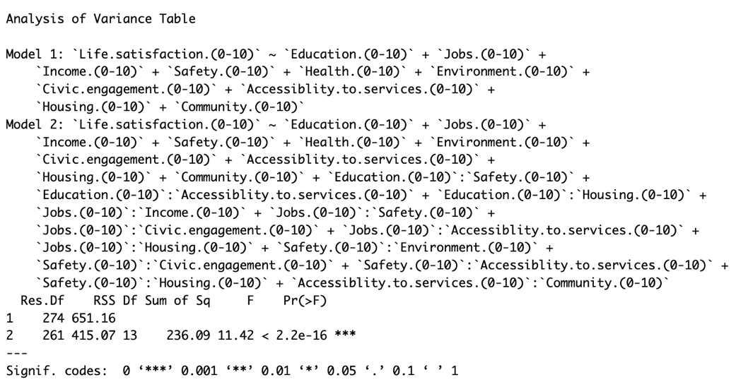
ANOVA Test Summary
Comparison: Model 3 vs. Model 1.
Degrees of Freedom: Reduced in Model 3 (261 vs. 274) due to 13 additional interaction terms.
Residual Sum of Squares (RSS):
Model 3: 415.07 (lower, explains more variability).
Difference in RSS: 236.09, indicating significant improvement.
Statistical Evidence:
F-statistic: 11.42.
p-value: < 2.2e-16 (highly significant).
Conclusion: Interaction effects in Model 3 significantly enhance fit but increase complexity.

Slide 22
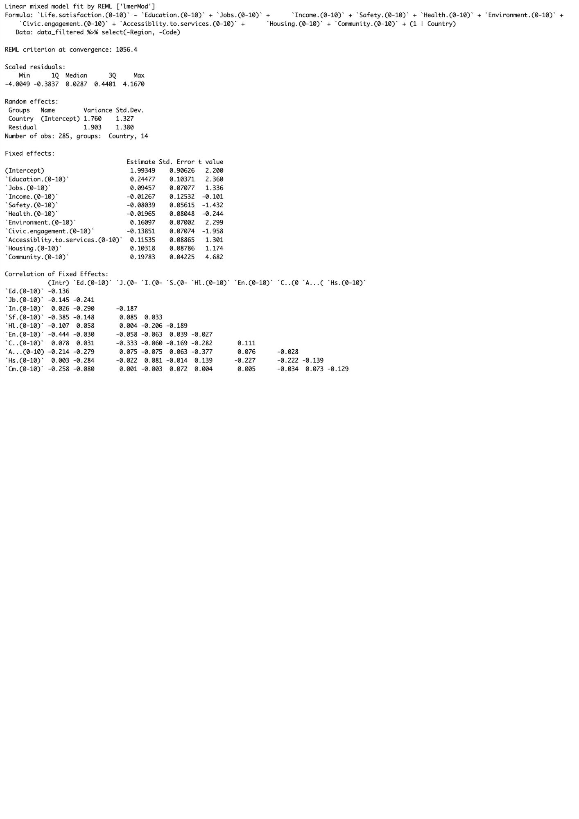
Model 4: Random Intercept Model
Purpose: Accounts for hierarchical structure (country-level variability).
Random Effects:
Between-Country Variance: 1.760 (SD = 1.327).
Within-Country Variance: 1.903 (SD = 1.380).
Significant Predictors (Fixed Effects):
Education: Positive (Estimate = 0.24477, p < 0.05).
Environment: Positive (Estimate = 0.16097, p < 0.05).
Community: Strong positive (Estimate = 0.19783, p < 0.001).
Non-Significant Predictors: Jobs, Income, Safety, Health, Housing, and Accessibility to Services.
Conclusion: The model captures country-level differences but does not outperform simpler models (Model 3) in terms of efficiency (AIC/BIC).

Slide 23
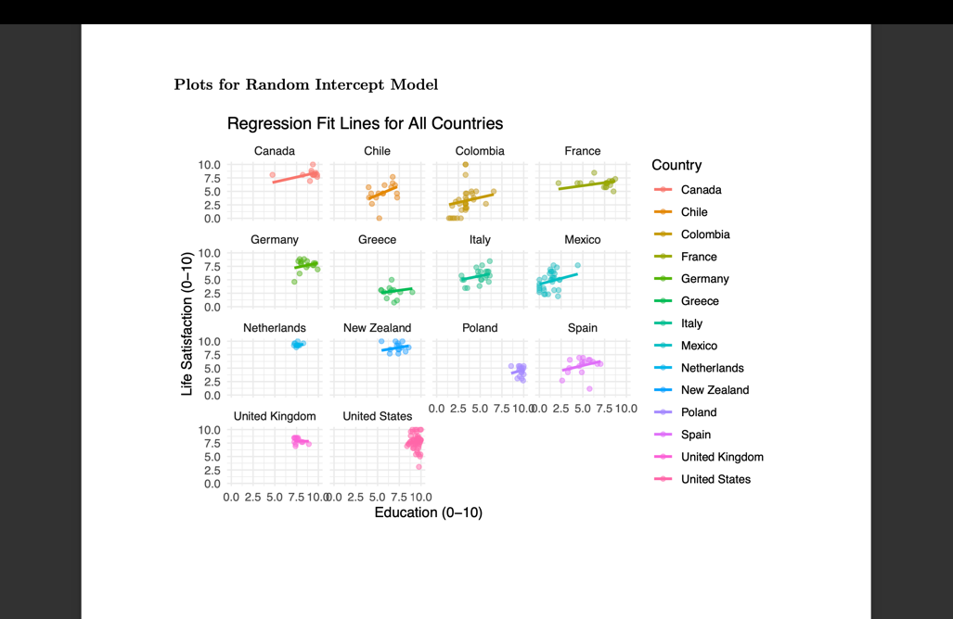
Model 4: Random Intercept Model

Slide 24
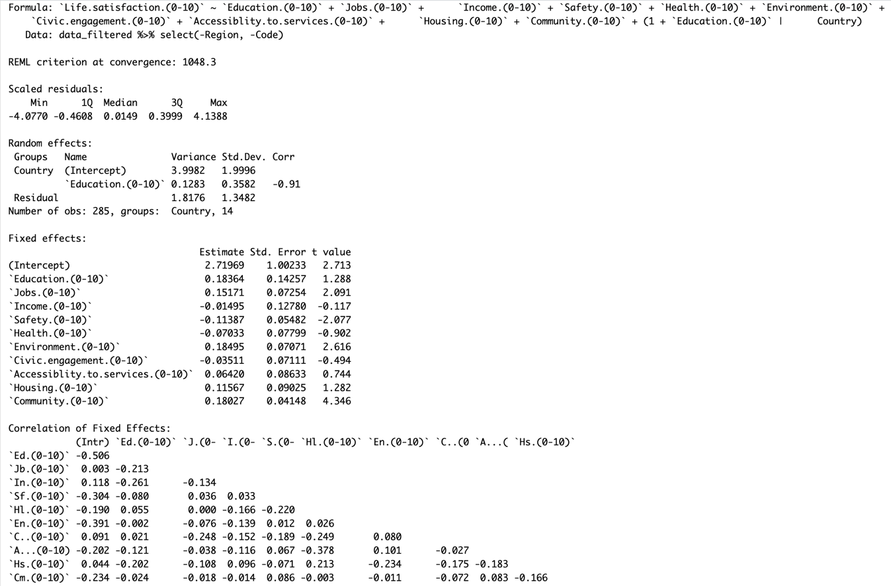
Model 5: Random Intercept Model with Random slope for Education
Purpose: Captures country-level variability in both baseline life satisfaction and the relationship between education and life satisfaction.
Random Effects:
Intercept Variance: 3.998 (SD = 1.999).
Slope for Education: Variance = 0.128 (SD = 0.358).
Residual Variance: 1.817 (SD = 1.348).
Correlation: -0.91 between intercept and slope (weaker education effect in countries with higher baseline life satisfaction).
Fixed Effects:
Significant Predictors:
Jobs: Positive (Estimate = 0.152, p < 0.05).
Environment: Positive (Estimate = 0.185, p < 0.01).
Community: Strong positive (Estimate = 0.180, p < 0.001).
Non-Significant Predictors: Education, Income, Health, and Accessibility.
Negative Effect: Safety (Estimate = -0.114, p < 0.05).
REML Criterion: 1048.3.
Residual Range: -4.077 to 4.139 (no extreme outliers)
Conclusion: Education’s impact varies by country, while Community, Jobs, and Environment are key drivers for tailored policy-making.

Slide 25
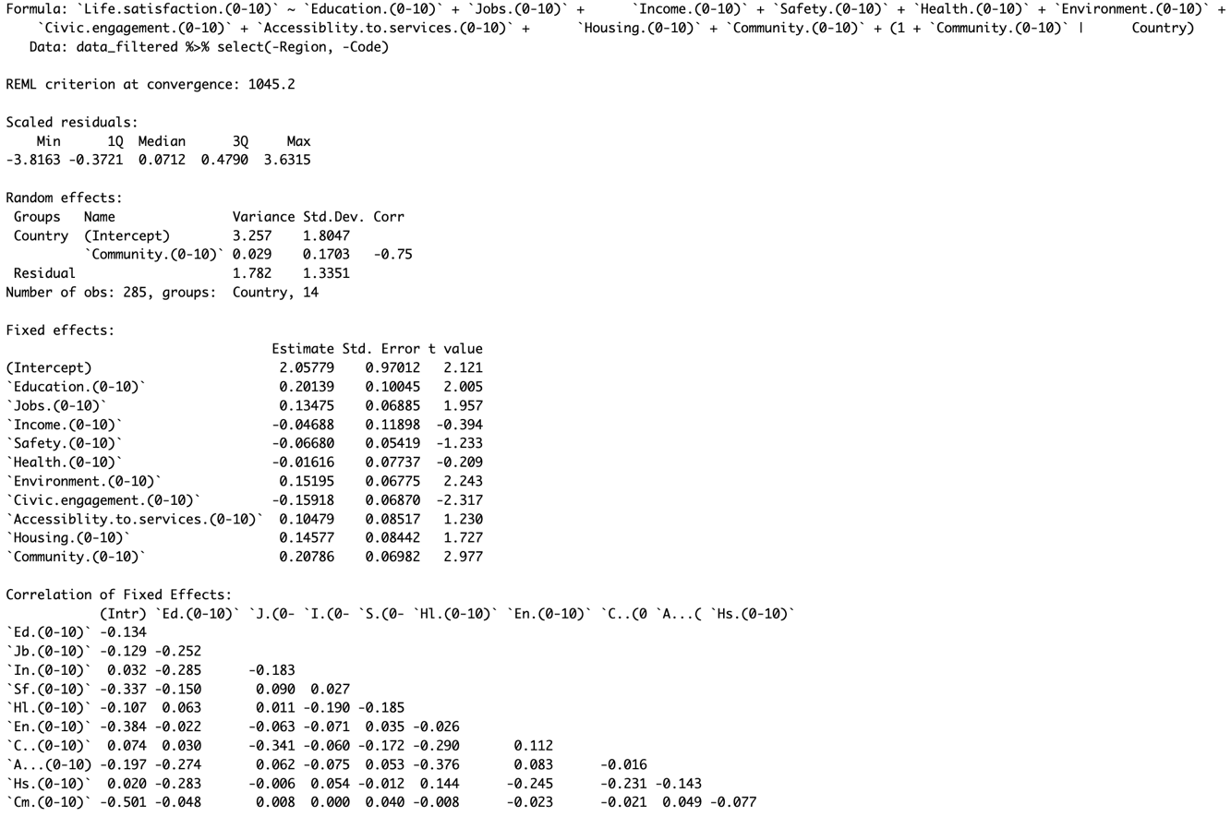
Model 6: Random Intercept Model with Random slope for Community
Purpose: Random intercepts and slopes for Community account for country-specific variations in life satisfaction. Negative correlation (-0.75) between intercept and slope: Higher baseline life satisfaction weakens the impact of community engagement.
Random Effects:
Country (Intercept): Variance = 3.257; substantial variability in baseline life satisfaction across countries.
Community Slope: Variance = 0.029; moderate variation in community’s impact on life satisfaction.
Residual Variance: 1.782; unexplained variation.
Fixed Effects (Significant Predictors):
Community (0.208): Strong positive impact on life satisfaction (t = 2.977).
Education (0.201): Positive association (t = 2.005).
Jobs (0.135): Contributes to life satisfaction (t = 1.957).
Environment (0.152): Positive relationship (t = 2.243).
Civic Engagement (-0.159): Negative association (t = -2.317).
Diagnostics:
Residuals clustered around zero, indicating good model fit.
Higher community impact in lower life satisfaction countries.
Conclusion: Strengthen Community Engagement to boost life satisfaction, especially in lower satisfaction countries. Invest in Education, Jobs, and Environmental Quality as key drivers. Rethink the role of Civic Engagement to optimize its impact.

Slide 26
Mixed Model comparison
Model | R-Squared Marginal | R-Squared Conditional
Random Intercept Model | 0.4164 | 0.6968
Random Intercept with Random Slope for Education | 0.4035 | 0.7139
Random Intercept with Random Slope for Community | 0.4277 | 0.7065
R-Squared Results: Random Intercept Model: Marginal R² = 41.64%, Conditional R² = 69.68%
Random Intercept with Random Slope for Education: Marginal R² = 40.35%, Conditional R² = 71.39%
Random Intercept with Random Slope for Community: Marginal R² = 42.77%, Conditional R² = 70.65%
Key Takeaway: All models explain substantial variance in life satisfaction, with Education model showing the highest overall fit. Random slopes for education and community improve the model's explanatory power across countries.

Slide 27
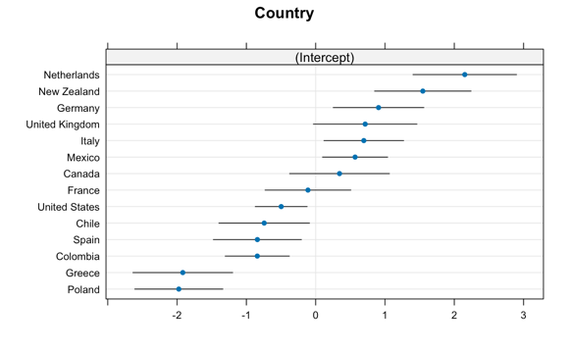
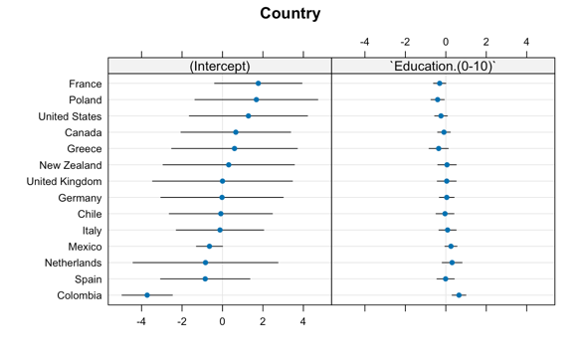
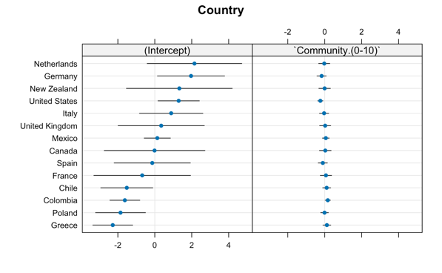
Dotplot of random effects from the model with a random intercept and random slope

Slide 28
Regression Models comparison
Model | AIC | BIC
Model 1 | 1068.28 | 1112.11
Model 2 | 977.15 | 1185.34
Model 3 | 965.94 | 1057.25
Model 4 (Random Intercept) | 1082.41 | 1129.89
Model 5 (RI+S_Edu) | 1078.27 | 1133.06
Model 6 (RI+S_Comm) | 1075.20 | 1129.99
Model 3 provides the best balance of accuracy and complexity.
Random slopes in Models 5 and 6 do not significantly improve fit, likely due to limited data.

Slide 29
Conclusion
The regression models provided robust insights into the relationships between these factors and life satisfaction.
Most important attributes regarding life satisfaction (taking into account the Model 3 results):
Most important attributes regarding life satisfaction (taking into account the Model 3 results):
Income
Community
Jobs
Interacting with Civic Engagement
Education x
Accessibility to Services
Safety x
Housing

Slide 30
THANK YOU!

